Slide 1
Process Control
Course II
Lecture
Closed Loop system
2

Slide 2
Development of Block Diagram for closed system
Consider the system shown below . We try to construct the block diagram for the CSTH and to find the transfer function ( Regulator and Servo)
The main components of the loop are :
- Process
- Measurement
- Controller
- Control Valve
m
cp
T_{i}
Temperature measuring element
M
Process
m
cp
T_{o}
Now we will discuss each components in details
Steam in
Q
Final control element
P
Controller
E
T_{m}
Control Valve
Comparator
T_{sp}

Slide 3
1. Process
Consider the heating tank which shown in Figure below. The tank represents the process in the closed loop system. Now we will try to find the transfer function for the process which relate the output variable $T_{o}\left(s\right)$ with input variables $T_{i}\left(s\right)$ and the rate of input heat $Q\left(s\right)$. Here we will assume that the mass flowrate input to the system (m) is constant. So $T_{o}\left(s\right)=f \left(T_{i}\left(s\right), Q\left(s\right)\right)$.
Now we try to find the transfer function of the process
which relate the output variable to the inlet variables.
m
T_{i}
cp
Heat balance
M
Process
m
To
cp
$$In=out+Accumulation$$
$$m . cp . Ti +Q = m. cp. To + M cp \frac{dT_{o}}{dt}$$
Q

Slide 4
$$\frac{M }{m}\frac{dT_{o}}{dt}+To=Ti+\frac{1}{m . cp} Q$$
$$τ\frac{dT_{o}}{dt}+To=Ti+k Q$$
$$τ=\frac{M }{m}$$
$$k=\frac{1}{m . cp}$$
$$\left(τs+1\right)T_{o}\left(s\right)=T_{i}\left(s\right)+k Q\left(s\right)$$
$$T_{o}\left(s\right)=\frac{1}{\left(τs+1\right)} T_{i}+\frac{k}{\left(τs+1\right)}Q\left(s\right)$$
$$\frac{ 1}{τs+1}$$
$Ti$(s)
+
$$\frac{ k}{τs+1}$$
∑
$To$(s)
$Q$(s)
+

Slide 5
2 Measuring Element
The temperature-measuring element, which senses the bath temperature $T_{o}$ and transmits a signal $T_{m}$ to the comparator.
$To$(s)
$T_{m}$(s)
$$G_{m}$$
In general the measuring element can be represented by one of the following forms:
$$G_{m}\left(s\right)=\frac{T_{m}(s)}{T_{o}(s)}=\frac{k_{m}}{τ_{m}s+1} …….. 1$$
Where $k_{m}$ is the steady – state gain of measuring element
${ τ}_{m}$ is time constant or lag of measuring lag.
Sometimes, the time constant of the measuring device $τ_{m}$ is so small that could be neglected, and then the transfer function becomes:
$$G_{m}\left(s\right)=\frac{T_{m}(s)}{T_{o}(s)}=k_{m} …….. 2$$

Slide 6
3- Comparator
The action of the comparator is to compare between the two signals; the output signal from the measuring element $T_{m}$ and the set point $T_{sp}$ which represent the desired value for the output variable. The output of the comparator represents the error signal $E$.
$$E(s)=T_{m}(s)−T_{sp}(s)$$
T_{sp}(s)
+
$$\sum{1}$$
E(s)
-
T_{m}(s)

Slide 7
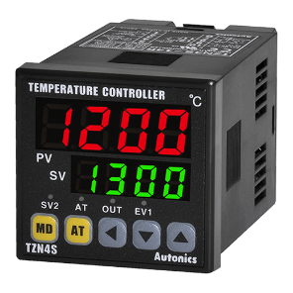
4. Controller
Actually, there are many types of controllers depending on their actions.
(Proportional, Integral, Derivative, Proportional- derivative, Proportional-Integral and Proportional-Derivative –Integral)
The input to the controller is the error signal E(s)
The output of the controller is hydraulic, pneumatic or electric signal.
The controller will manipulate the error signal in such a way to reduce or eliminate the error signal.
In general, The output of the controller is hydraulic, pneumatic or electric signal that transfers to the final control element. Here, we shall take the type of the controller as proportional and the output signal is pneumatic p(s), so the transfer function of the controller $G_{c}(s)$ will be:
$$G_{c}(s)=\frac{P(s)}{E(s)}=K_{c}$$
E (s)
$$G_{c}$$
P (s)
E (s)
$$K_{c}$$
P (s)

Slide 8
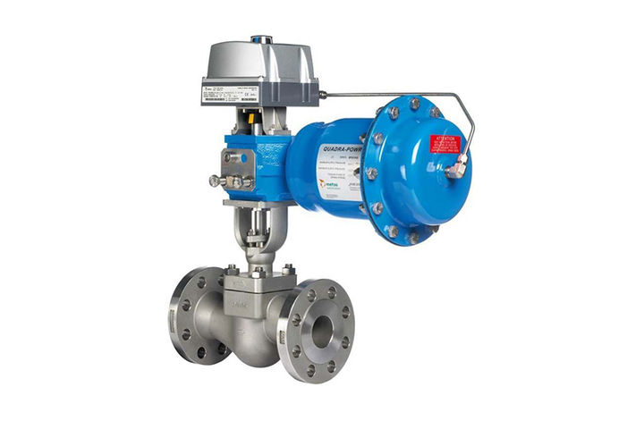
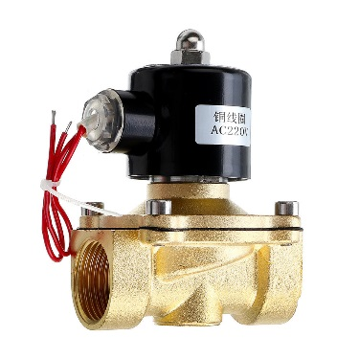
Final control Element (Control valve)
Usually, the final control element may be
- control valve which operates pneumatically or
- solenoid valve which operates electrically.
The input variable to the valve is pressure signal
The output will affect the manipulating variable ( in our example is Q)
Mostly, the transfer function of the final control element can be represented by either
- first - order lag $G_{v}\left(s\right)=\frac{Q\left(s\right)}{p\left(s\right)}=\frac{K_{v}}{τ_{v}s+1}$
or
- constant. $G_{v}\left(s\right)=\frac{Q\left(s\right)}{p\left(s\right)}= K_{v}$
Control Valve
Solenoid Valve
P (s)
G_{v} (s)
$Q$ (s)

Slide 9
The Block diagram of the closed loop system can be given as in Figure below
$Ti$(s)
$$\frac{ 1}{τs+1}$$
+
+
$E$(s)
$P$(s)
$Q$(s)
+
$Tsp$(s)
$$\frac{k_{v} }{τvs+1}$$
$$\frac{ k}{τs+1}$$
∑
$$k_{c}$$
∑
$To$(s)
_
$Tm$(s)
$$\frac{k_{m} }{τms+1}$$

Slide 10
Representation of closed loop system by symbols and signal transmitters
The elements of the closed loop system can be represented by symbols and signals transmitters.
Figure below shows the signal transmitter and symbols between measuring element and control valve
set point
Measuring element
X T
X C
Control valve
Transmitter
Controller
Variable | X
Temperature | T
Flow | F
Pressure | P
Level | L
Concentration | C

Slide 11
set point
T T
T C
Control valve
Measuring element
Temperature
Controller
Temperature
Transmitter
set point
F T
F C
Control valve
Measuring element
Flow
Controller
Flow
Transmitter

Slide 12
set point
L T
L C
Control valve
Measuring element
Level
Controller
Level Transmitter
set point
C T
C C
Control valve
Measuring element
concentration
Controller
concentration Transmitter

Slide 13
The type of Signal transmitter can be represented by lines as follows:
Signal type | symbol
Electric signal
Pneumatic signal
Hydraulics signal
set point
F T
F C
Control valve
Measuring element
Flow
Controller
Flow
Transmitter

Slide 14
m
cp
T_{i}
m
cp
T_{i}
Temperature measuring element
M
M
Process
m
cp
T_{o}
Process
m
cp
T_{o}
Steam in
Steam in
Q
T T
Q
Final control element
P
Controller
E
T_{m}
Tc
Control Valve
Comparator
T_{sp}
Set point

Slide 15
Example 1 Consider the mixing system shown in Fig below
Given the following data:
$q_{i}=7 lit/sec$ , $V=14 lit$ $G_{v}=1.5 , G_{m}=2, G_{c}=0.75$
Find the followings:
The transfer functions: $\frac{C_{o}\left(s\right)}{C_{i}\left(s\right)} and \frac{C_{o}\left(s\right)}{C_{sp}\left(s\right)}$ and sketch the signal flow diagram
The final value of $C_{o}$ for step change in $C_{i}$ of value 2 units.
The final value of $C_{o}$ for step change in $C_{sp}$ of value 3 units.
Pure A
d=2 cm
6 m
m (mole/s)
q_{i}
_{Ci}
$$C_{i}^{′}$$
Set point
CC
V
CT
$$C_{o}^{′}$$
d=3 cm
q
c_{o}
9 m

Slide 16
Solution
Process
$q_{i}C_{i}^{′}+m=q_{i}C_{o}^{′}+V\frac{dC_{o}^{′}}{dt}$
$$\frac{V}{q_{i}}{ \frac{dC_{o}^{′}}{dt}+C_{o}^{′}=C}_{i}^{′}+\frac{1}{q_{i}}m$$
$$\left(τs+1\right){ C_{o}^{′}\left(s\right)=C}_{i}^{′}\left(s\right)+\frac{1}{q_{i}}m\left(s\right) ……..(1)$$
But $\frac{C_{o}\left(s\right)}{C_{o}^{′}\left(s\right)}= e^{−τ_{D2}s}$
$$C_{o}^{′}\left(s\right)=\frac{C_{o}\left(s\right)}{e^{−τ_{D2}s}} ……….. (2)$$
Pure A
d=2 cm
6 m
m (mole/s)
q_{i}
_{Ci}
$$C_{i}^{′}$$
V
$$C_{o}^{′}$$
d=3 cm
q
c_{o}
9 m
$$\frac{C_{i}^{′}\left(s\right)}{C_{i}\left(s\right)}= e^{−τ_{D1}s}$$
$$C_{i}^{′}\left(s\right)=C_{i}\left(s\right). e^{−τ_{D1}s} …….. (3)$$
Subs Eq. (3) and (2) in (1)

Slide 17
$$\left(τs+1\right)C_{o}\left(s\right).e^{τ_{D2}s}=C_{i}\left(s\right). e^{−τ_{D1}s}+\frac{1}{q_{i}}m\left(s\right)$$
$$(τs+1)C_{o}\left(s\right).=C_{i}\left(s\right). e^{−{(τ}_{D1}+τ_{D2})s}+\frac{e^{−τ_{D2}s}}{q_{i}}m(s)$$
$C_{o}\left(s\right)=\frac{e^{−{(τ}_{D1}+τ_{D2})s}}{\left(τs+1\right)} C_{i}\left(s\right)+\frac{e^{−τ_{D2}s}}{q_{i}\left(τs+1\right)} m\left(s\right)$
$$τ=\frac{V}{q_{i}}=\frac{14}{7}=2,$$
$$τ_{D1}=\frac{V_{i}}{q_{i}}=\frac{\frac{π}{4}d_{i}^{2}L_{1}}{q_{i}}=\frac{\frac{π}{4}{\left(0.02\right)}^{2}\left(6\right)}{\frac{7}{1000}}=0.27$$
$$τ_{D2}=\frac{V_{o}}{q_{o}}=\frac{\frac{π}{4}d_{2}^{2}L_{2}}{q_{o}}=\frac{\frac{π}{4}{\left(0.03\right)}^{2}(9)}{7/1000}=0.9$$
$C_{o}\left(s\right)=\frac{e^{−(0.9+0.27)s}}{2s+1} C_{i}\left(s\right)+\frac{e^{−0.9s}}{7(2s+1)} m\left(s\right)$
Pure A
d=2 cm
6 m
m (mole/s)
q_{i}
_{Ci}
$$C_{i}^{′}$$
Set point
CC
V
CT
$$C_{o}^{′}$$
d=3 cm
q
c_{o}
$C_{o}\left(s\right)=\frac{e^{−1.17s}}{2s+1} C_{i}\left(s\right)+\frac{e^{−0.9s}}{7(2s+1)} m\left(s\right)$
9 m

Slide 18
$C_{o}\left(s\right)=\frac{e^{−1.17s}}{2s+1} C_{i}\left(s\right)+\frac{e^{−0.9s}}{7(2s+1)} m\left(s\right)$
$Ci$(s)
$$\frac{e^{−1.17s}}{2s+1}$$
$$G_{v}=1.5 , G_{m}=2, G_{c}=0.75$$
$E$(s)
$P$(s)
$m$(s)
+
+
$Csp$(s)
+
$$\frac{e^{−0.9s}}{7(2s+1)}$$
$Co$(s)
∑
$$0.75$$
$$1.5$$
∑
_
$Cm$(s)
$$2$$
a. Transfer function $\frac{C_{o}\left(s\right)}{C_{i}\left(s\right)}=\frac{\frac{e^{−1.17s}}{2s+1}}{1+ \frac{0.75∗1.5∗e^{−0.9s}∗2}{7(2s+1)}}=\frac{\frac{e^{−1.17s}}{2s+1}}{1+ \frac{0.32e^{−0.9s}}{2s+1}}$
$$\frac{C_{o}\left(s\right)}{C_{sp}\left(s\right)}=\frac{(0.75)(1.5)\frac{e^{−1.9s}}{\left.7(2s+1\right)}}{1+ 2(0.75)(1.5)\frac{e^{−0.9s}}{\left.7(2s+1\right)}}=\frac{0.16\frac{e^{−1.9s}}{\left(2s+1\right)}}{1+ \frac{0.3214e^{−1.9s}}{\left(2s+1\right)}}$$

Slide 19
b.
$$\frac{C_{o}\left(s\right)}{C_{i}\left(s\right)}=\frac{\frac{e^{−1.17s}}{2s+1}}{1+ \frac{0.32e^{−0.9s}}{2s+1}}$$
$$C_{i}\left(s\right)=\frac{2}{s} step change$$
$$C_{o}\left(s\right)=C_{i}\left(s\right) \frac{\frac{e^{−1.17s}}{2s+1}}{1+ \frac{0.32e^{−0.9s}}{2s+1}}= \frac{2}{S}[ \frac{\frac{e^{−1.17s}}{2s+1}}{1+ \frac{0.32e^{−0.9s}}{2s+1}}]$$
$$C_{o}\left(∞\right)=\lim_{s→0}{s∗C_{o}(s)}=1.515$$
$$C_{o}\left(s\right)=C_{sp}\left(s\right)∗\frac{0.16\frac{e^{−1.9s}}{\left(2s+1\right)}}{1+ \frac{0.3214e^{−1.9s}}{\left(2s+1\right)}}=\frac{3}{s}∗\frac{0.16\frac{e^{−1.9s}}{\left(2s+1\right)}}{1+ \frac{0.3214e^{−1.9s}}{\left(2s+1\right)}}$$
C.
$$C_{o}\left(∞\right)=\lim_{s→0}{s∗C_{o}(s)}=0.363$$

Slide 20
Example 2
For the liquid- level system shown in the Figure below, find
The transfer function of the process.
Sketch the signal flow block diagram.
$$q_{i}$$
c. The T.F $\frac{H\left(s\right)}{H_{sp}\left(s\right)}$
d. The response of H if a unit step change occurs in set point and sketch it.
LC
$$H$$
LT
V
$$R_{1}$$
$$q_{o}$$
Given the following data: $A=1 m^{2}$ ,$R_{1}=2$, $q=10 lit/min$, $V=5 lit$, $G_{v}=1.5$, $G_{m}=1$, $G_{c}=1$

Slide 21
C.V
a.
$$q_{i}$$
Process.
Material balance
$$q_{i}=q_{o}+A\frac{dH}{dt}$$
$$q_{i}=\frac{H_{i}}{R_{1}}+A\frac{dH}{dt}$$
$$R_{1}A\frac{dH}{dt}+H={R_{1}q}_{i}$$
$$τ \frac{dH}{dt}+H={R_{1}q}_{i}$$
$$\left(τs+1\right)H\left(s\right)={R_{1}q}_{i}(s)$$
$H\left(s\right)=\frac{R_{1}}{τs+1}q_{i}\left(s\right), R=2, τ=R.A=2$
$$H\left(s\right)=\frac{2}{2s+1}q_{i}\left(s\right)$$
Set point
LC
$$H$$
LT
V
$$R_{1}$$
$$q_{o}$$
$$q_{i}$$
$$H$$
V
$$R_{1}$$
$$q_{o}$$
There is only Process G_{p}, no load G_{L} exist
$$G_{p}\left(s\right)=\frac{H\left(s\right)}{q_{i}\left(s\right)}=\frac{2}{2s+1}$$

Slide 22
b.
+
E(s)
$$\frac{2}{2s+1}$$
$H$(s)
$Hsp$(s)
$$1.5$$
-
c.
Note that Gc=1 and Gm=1 , and no need to put them in the block diagram.
$$\frac{H\left(s\right)}{H_{sp}\left(s\right)}= \frac{\frac{1.5∗2}{2s+1}}{1+ \frac{1.5∗2}{2s+1}}=\frac{3}{2s+4}$$
$$G\left(s\right)=\frac{H\left(s\right)}{H_{sp}\left(s\right)}=\frac{3/4}{0.5s+1}=\frac{0.75}{0.5s+1}$$
d.
Response for unit step change in servo
$$H(t)$$
$$H\left(s\right)=ℒ^{−1}H_{sp}\left(s\right).G\left(s\right)$$
$$0.75$$
$$H\left(s\right)=ℒ^{−1}\frac{1}{s}.\frac{0.75}{0.5s+1}=0.75(1−e^{−2t})$$
0
$$t$$

Slide 23
The End
Thank you for listening
Any ?

